Slide 1
Big Data & The Cloud
Big Data
Emergent Data sources generate a huge amount of information
New tools have the capability to handle high-volume data sources
“The Cloud”
Speaks to WHERE data operations happen
Companies ‘rent’ hardware capacity, software & services
Operations happen in the third party’s data center(s)

Slide 2
Big Data
< Use a hi-resolution version of the diagram on the next page>
http://mattturck.com/wp-content/uploads/2016/03/Big-Data-Landscape-2016-v18-FINAL.png

Slide 3
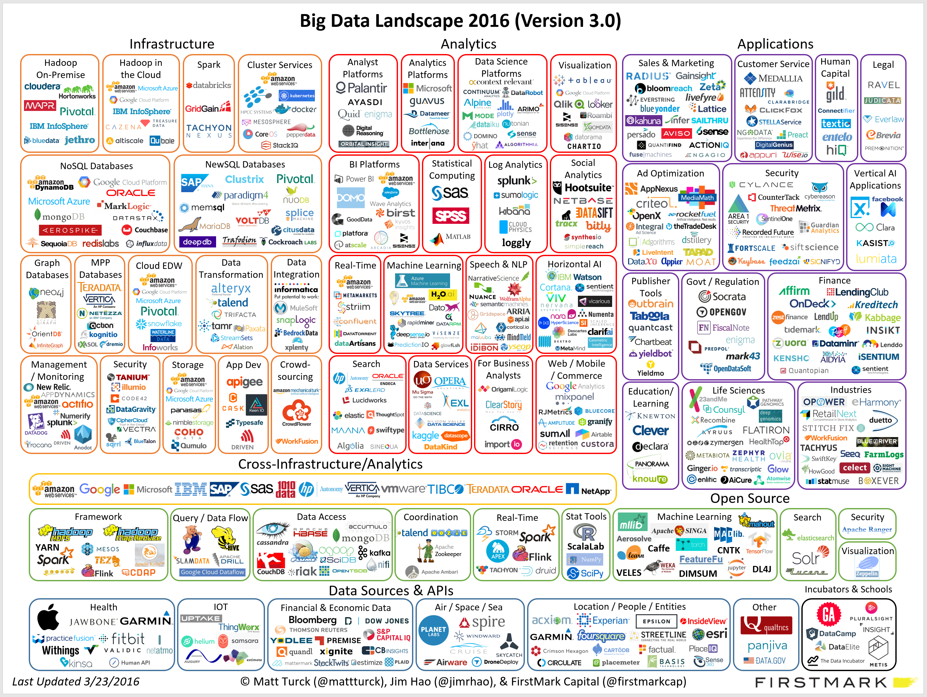
Big Data & The Cloud

Slide 4
Big Data
Data Analytics & Business Intelligence
languages
DATA SOURCES
Data Ingestion
Pre-Processing
Data Integration
Data Storage
Structured Unstructured
languages
languages
Infrastructure

Slide 5
Big Data - Streaming Data
< Streaming – ideally we have an image or animation that shows the fish analogy >

Slide 6



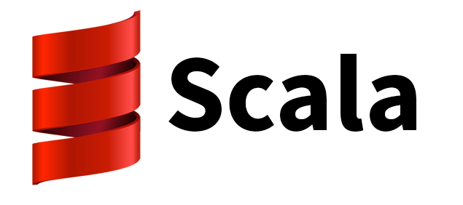
Big Data - Streaming Data
< clip the “Spark” “Data Transformation” “Data Integration” and “Real-Time” boxes from the landscape image and line up left to right”
< add in the following language icons >

Slide 7
Big Data - Storage
< clip the Hadoop On-Premise, Hadoop in the Cloud, NoSQL Databases, NewSQL databases, Graph databases, MPP Databases, and Cloud EDW boxes from the landscape arrange >

Slide 8
Big Data - Analytics
< show analytics section from landscape>

Slide 9


Big Data - Infrastructure

Slide 10
The Cloud
Software as a Service (Saas)
Software hosted on machines provided by third party
Applications accessed remotely via client and/or the Web
Targeted at application end users
Platform as a Service (PaaS)
Development environment hosted by third party
Targeted at developers
Infrastructure as a Service (IaaS)
Raw building blocks of data environment provided by third party
Processing capacity, storage, connectivity, security, etc.

Slide 11

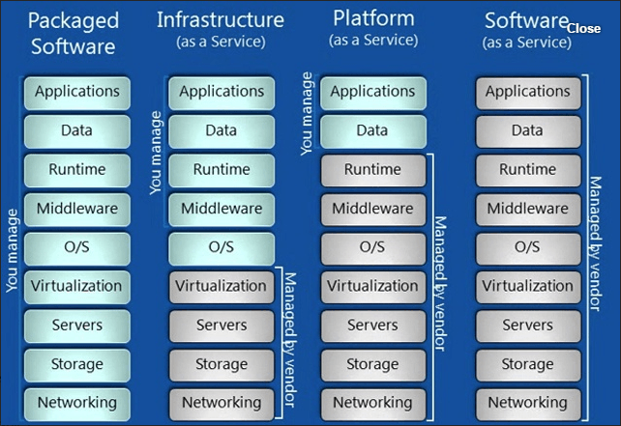
The Cloud

Slide 12
The Cloud
Why the Cloud is Attractive
Inexpensive & easy to set up
Can scale quickly and easily
Less distraction & overhead
Why not go to the Cloud?
Control & security
Inertia & existing resource investment
Highly unique needs
Location of source data
Scale

Slide 13
Recap
Big Data
Ingest & process data
Store structured & unstructured data
Enable analytics on data
Provide infrastructure
Cloud Computing
SaaS, PaaS, IaaS
Pro/cons
How it can work with Big Data

